Slide 1
Diabetes mellitus : classification , etiopathogenesis, clinical features, diagnosis management
Dr Nishesh jain
Assistant professor
Department of Endocrinology

Slide 2
Definition
Diabetes is a group of metabolic diseases characterized by hyperglycemia resulting from defects in insulin secretion, insulin action, or both. The chronic hyperglycemia of diabetes is associated with long-term damage, dysfunction, and failure of different organs, especially the eyes, kidneys, nerves, heart, and blood vessels. (American Diabetes Association)

Slide 3
Types
Type 1 Diabetes (IDDM)
Type 2 Diabetes(NIDDM)
Gestational Diabetes
Other specific types

Slide 4
TYPE 1 DIABETES MELLITUS(IDDM)
It occurs mostly in young group of patients <30 years.
Insulin deficiency results due to destruction of beta cells
Etiolopathogenesis- T cell mediated autoimmune destruction of beta cells /glutamic acid decarboxylase antibodies (GAD Abs)
Genetic predisposition (HLA- DR3 DR4 genes) 30-50% concordance in identical twins
Environmental factors (viruses, excessive coffee intake, stress, cow milk in newborn )
It is usually associated with thyroid disease, Addison disease ,Pernicious anemia, Coelic disease.

Slide 5
TYPE 2 DIABETES MELLITUS (NIDDM)
It mostly affects middle age and older people (>30 years)
It occurs due to Insulin resistance and beta cell exhaustion (relative insulin deficiency)
High insulin levels in the early stage is characteristic.
Etiopathogenesis-Central obesity ( ↑FFA compete with glucose for oxidation ,adipokines decreases sensitivity of insulin receptors ,inhibits gluconeogenesis). Metabolic syndrome (obesity, hypertension, ↑LDL, ↑TAGs etc) Genetic predisposition (TCFL2 gene) BMI >30 kg/m2 .

Slide 6
MATURE ONSET DM (MODY)
A type of type 2 DM occurring in young people It is of further subtypes
MODY 1 (HNF 4a deficiency)
MODY 2 (glucokinase deficiency)
MODY 3 (HNF 1a deficiency)
MODY 4 (IPF-1 deficiency)
MODY 5 HNF-1b deficiency)

Slide 7
GESTATIONAL DIABETES (GDM)
It is the hyperglycemia occurring for the first time during pregnancy
Etiopathogenesis- Placental hormones reduce the sensitivity of insulin receptors resulting in hyperglycemia and insulin doesn’t meet body requirement and beta cell exhaustion occurs.

Slide 8
OTHER SPECIFIC TYPES
Genetic defects of beta cells
Genetic defects of insulin action e.g lipodystrophy
Pancreatic disease (pancreatitis,cystic fibrosis,neoplasm,hemochromatosis)
Drug induced DM (steroids,thiazides,diuretics)
Viral (congenital rubella,mumps, coxasackie )
Uncommon form of immune mediated DM
Endocrine Induced DM (thyrotoxicosis,Cushing syndrome,acromegaly,pheochromocytoma)

Slide 9
Genetic defects in insulin action
Type A insulin resistance
Leprechaunism
Rabson-Mendenhall syndrome
Lipoatrophic diabetes
Others

Slide 10
Diagnosis
Fasting PG > 126mg% (8 hrs. non caloric intake).
Postprandial PG > 200mg% ( glucose load containing the equivalent of 75 g anhydrous glucose).
Symptoms of diabetes plus Random Blood Glucose > 200mg%.

Slide 12
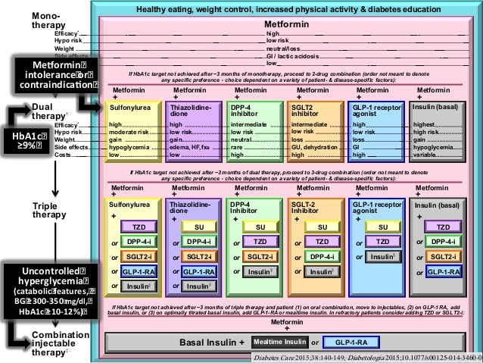
Management of diabetes

